Slide 1

CTEC 298 Final Project
By: Saniya Isaac, Andrea Redman
CTEC 298

Slide 2

Introduction
This presentation covers what we learned and completed in CTEC 128 and CTEC 298.
We'll begin with a quick overview of both courses and how they connect.
You'll see summaries of our CTEC 128 projects, including the data we used and key findings.
Then we'll walk through the materials we submitted for CTEC 298.
We'll also describe the Python and Tableau plots we created and explain what they show.
Finally, we'll end with a summary of what we learned and the skills we gained from both courses.

Slide 3
CTEC 128 (Group Leader)
Studied whether Black drivers in Maryland are more likely than White drivers to be pulled over for expired license plates.
Used traffic stop data from Maryland’s 2017 Race-Based Traffic Stop Data Dashboard.
Focused on key features: race/ethnicity, stop reasons, and population demographics.
Worked with raw data from official PDF reports and converted the figures into structured data tables.
Performed Exploratory Data Analysis (EDA) to explore differences in stop percentages by race.
Found that Black drivers made up 29% of Maryland’s population but accounted for 40% of traffic stops, while White drivers were 51% of the population but only 44% of stops.
Results suggest that Black drivers are stopped more often than expected based on their population share, pointing to possible racial bias in traffic enforcement.

Slide 4
CTEC 128 (Member 1)
Studied the impact of the Affordable Care Act (ACA) on access to health coverage in California.
Used health data from 2008 (pre-ACA) and 2016 (post-ACA) to compare changes over time.
Focused on key features: income level, race/ethnicity, age group (18–64), and health insurance status.
Worked with raw data from the American Community Survey and cleaned it for analysis.
Applied data wrangling (fixing missing values, combining features, categorizing columns).
Performed Exploratory Data Analysis (EDA) to find trends and patterns in the data.
Created visualizations (bar charts, age comparisons, race vs coverage graphs) to highlight findings.
Found that health insurance rates increased after the ACA, especially for low-income and minority groups.

Slide 5


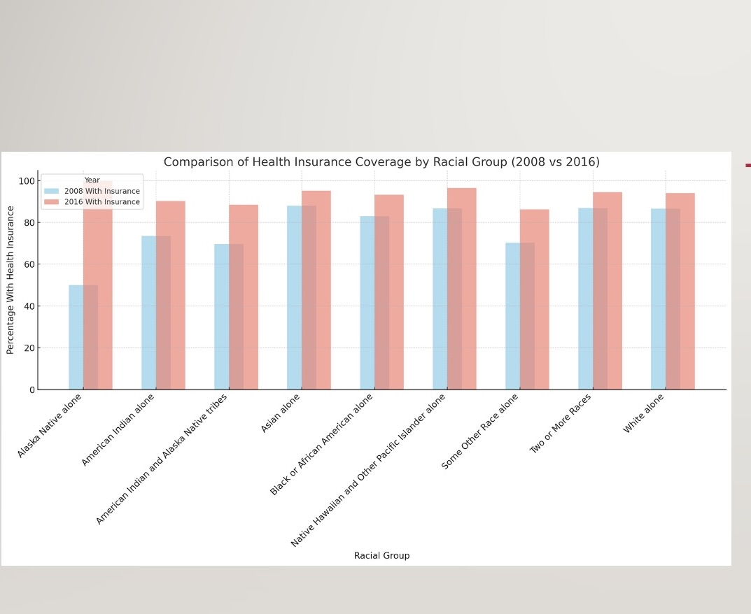


Health Insurance Coverage by Race (2008 vs. 2016)

Slide 6
CTEC 298 Material Submitted (Group Leader)
Completed multiple assignments focused on Python programming, data analysis, and data visualization.
Practiced basic Python functions through the LearnPython tutorials.
Used Jupyter Notebook to run and test Python code step by step, which helped organize and understand the code better.
Completed the Matplotlib assignment, creating six different types of plots.
Designed and presented a bar plot presentation explaining how to create bar plots and why they are useful in data analysis.
Learned to use Tableau to build two visual charts for presenting data.
Used GitHub and Google Drive to store, organize, and back up all assignments and code.
Gained hands-on experience with real data and professional tools for data visualization and analysis.

Slide 7
CTEC 298 Material Submitted (Member 1)
Python Basics (LearnPython1 & 2): Completed beginner lessons to learn how to use Python for reading files, using variables, loops, and writing simple code.
Jupyter Notebook Coding: Practiced writing and testing Python code in a step-by-step format using Jupyter Notebooks, which made it easier to organize and run code blocks.
Matplotlib (6 Plots): Created six different chart types using Matplotlib: bar plot, pie chart, histogram, scatter plot, stack plot, and multiplot, based on real health data.
Scatter Plot Presentation: Made a presentation that explained what a scatter plot is, how it shows relationships between variables, and why it’s useful in data science.
Pandas Assignment (DataFrame): Used Pandas to load the 2008 and 2016 health data, turned it into a DataFrame, and explored it using functions like .head() and .info().
Tableau Plots (Bar Chart & Circle Chart): Built two visualizations in Tableau one comparing racial group counts, and another showing health insurance coverage in a simple, clear way.
GitHub Used to Store Work: Uploaded all assignments to GitHub to organize, share, and back up all my project files and code.

Slide 8
Plot Deliverables (Group Leader)

Slide 9
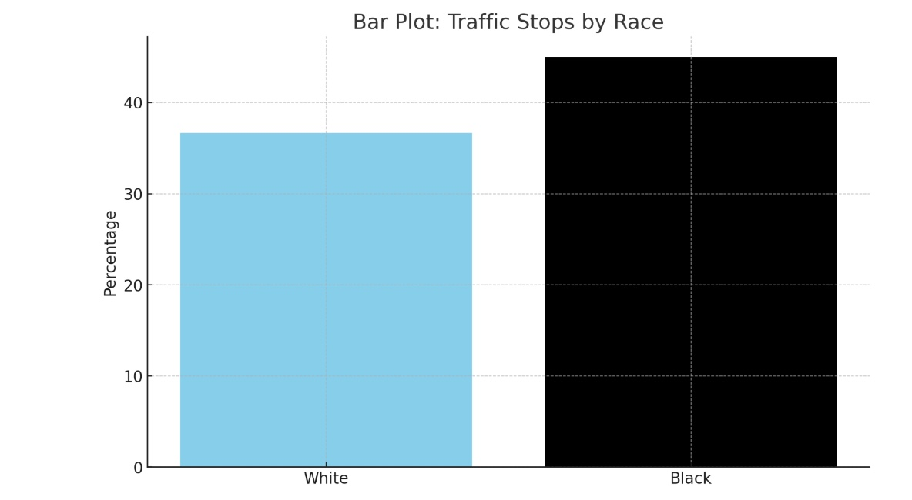
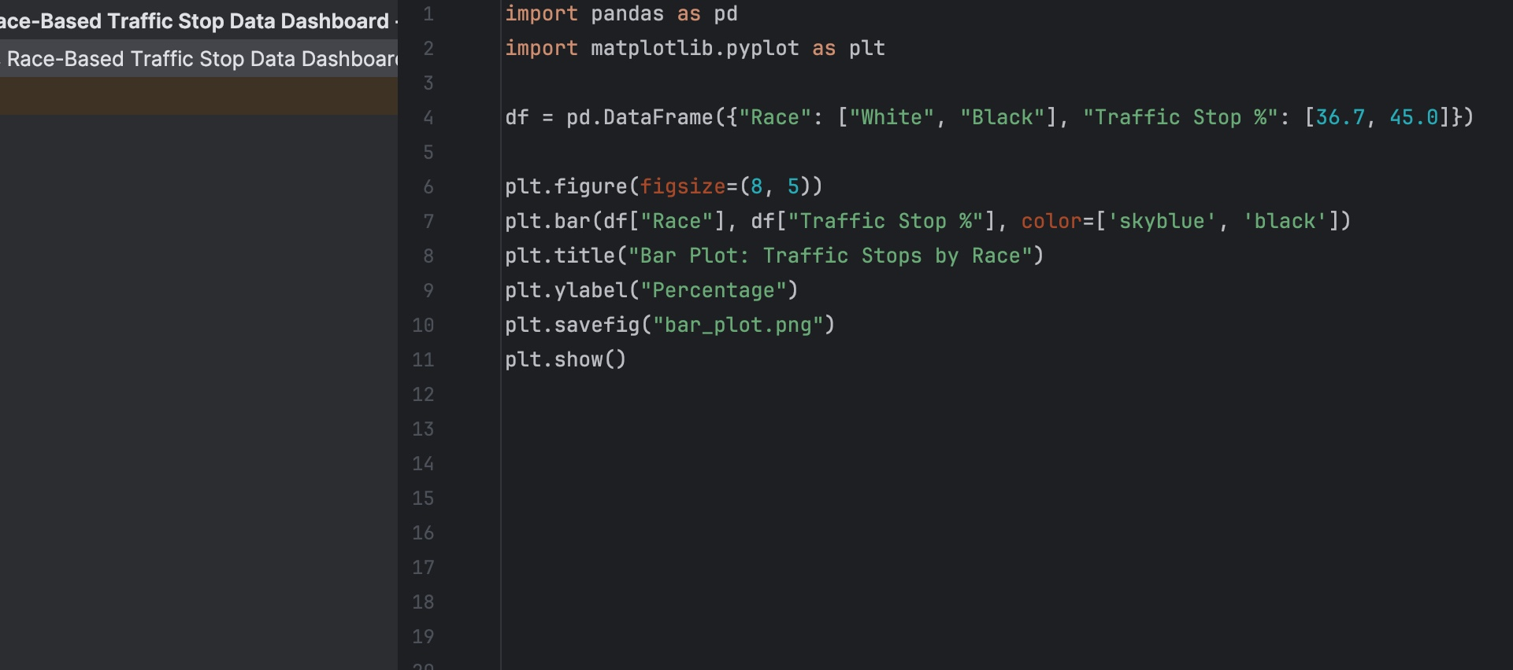

Slide 10
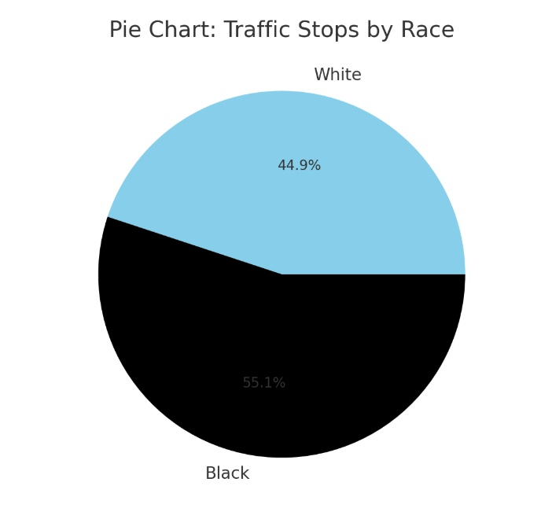
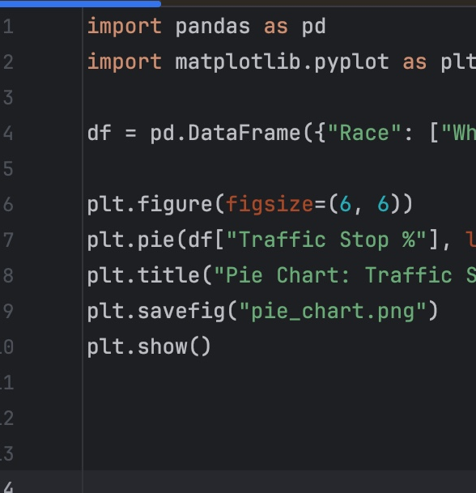

Slide 11
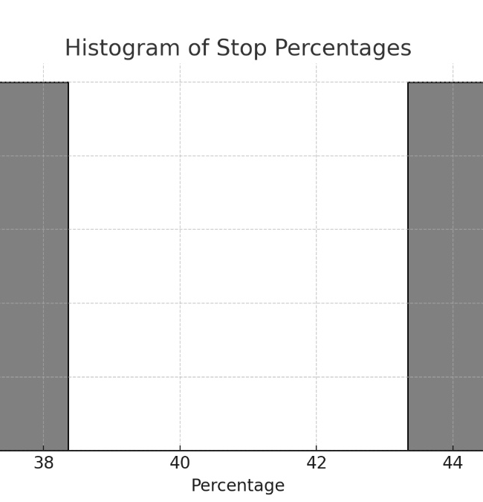
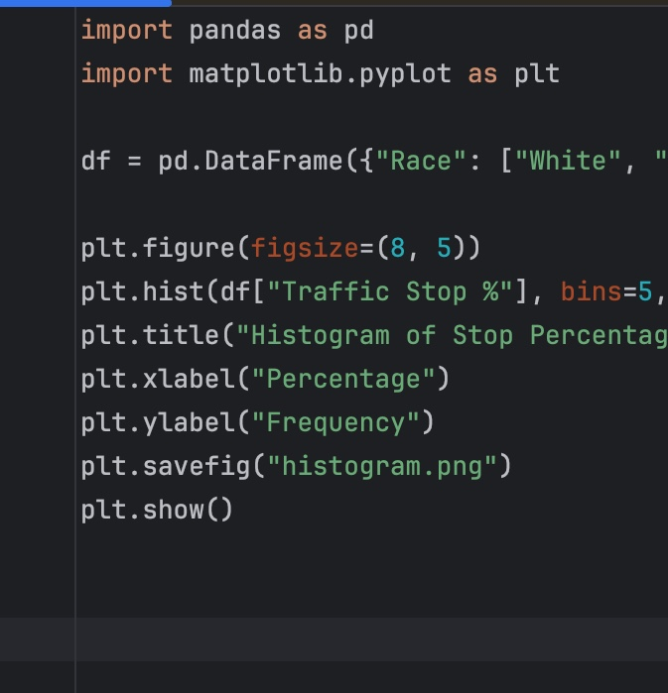

Slide 12
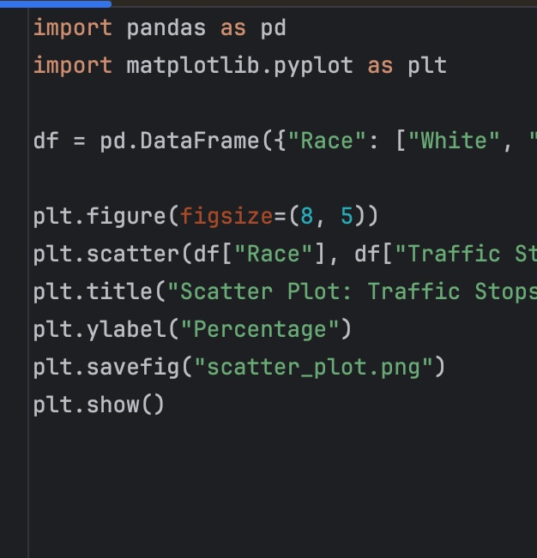
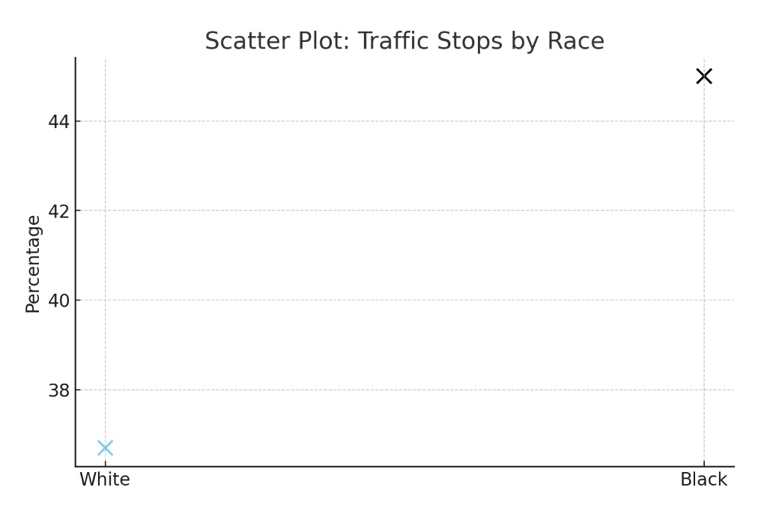

Slide 13
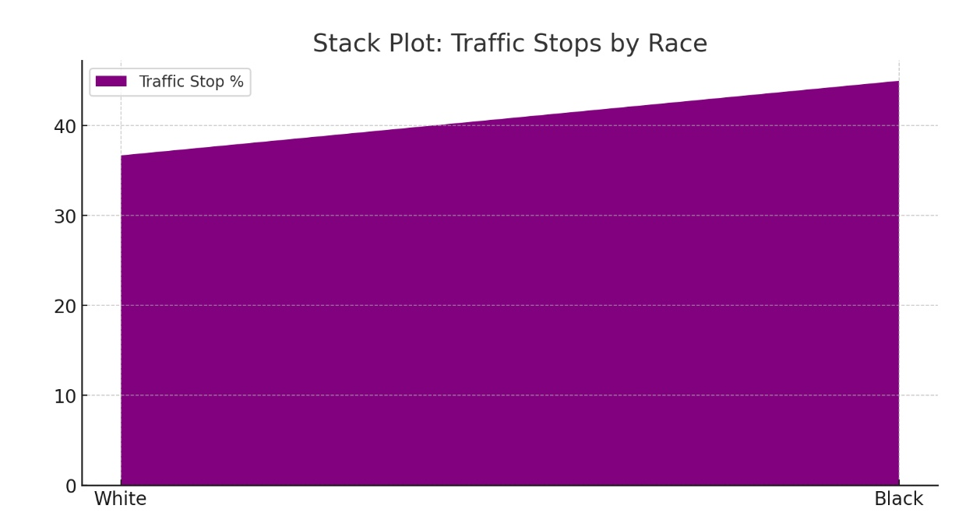
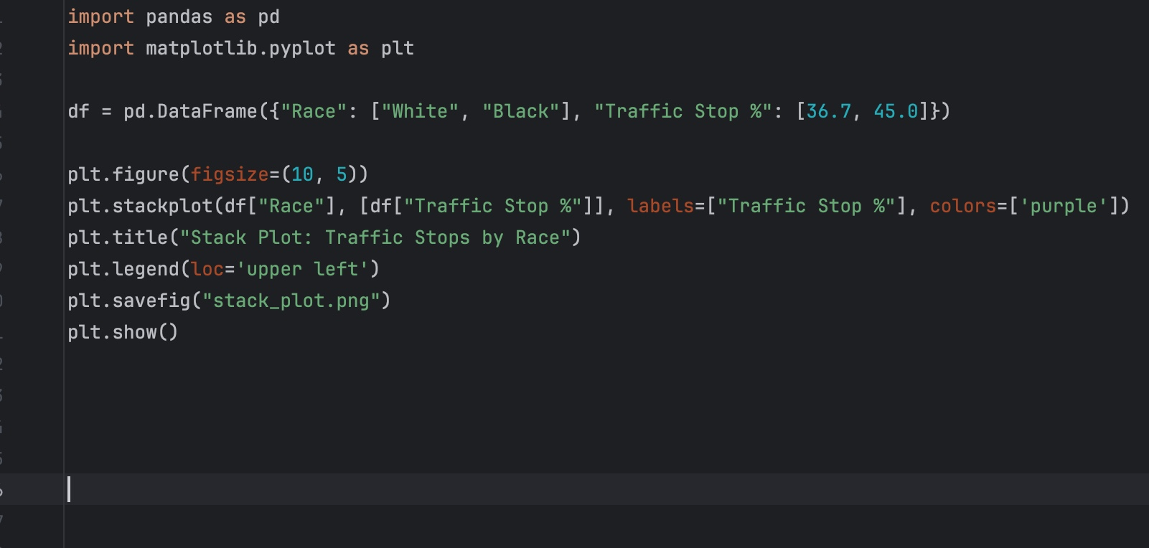

Slide 14
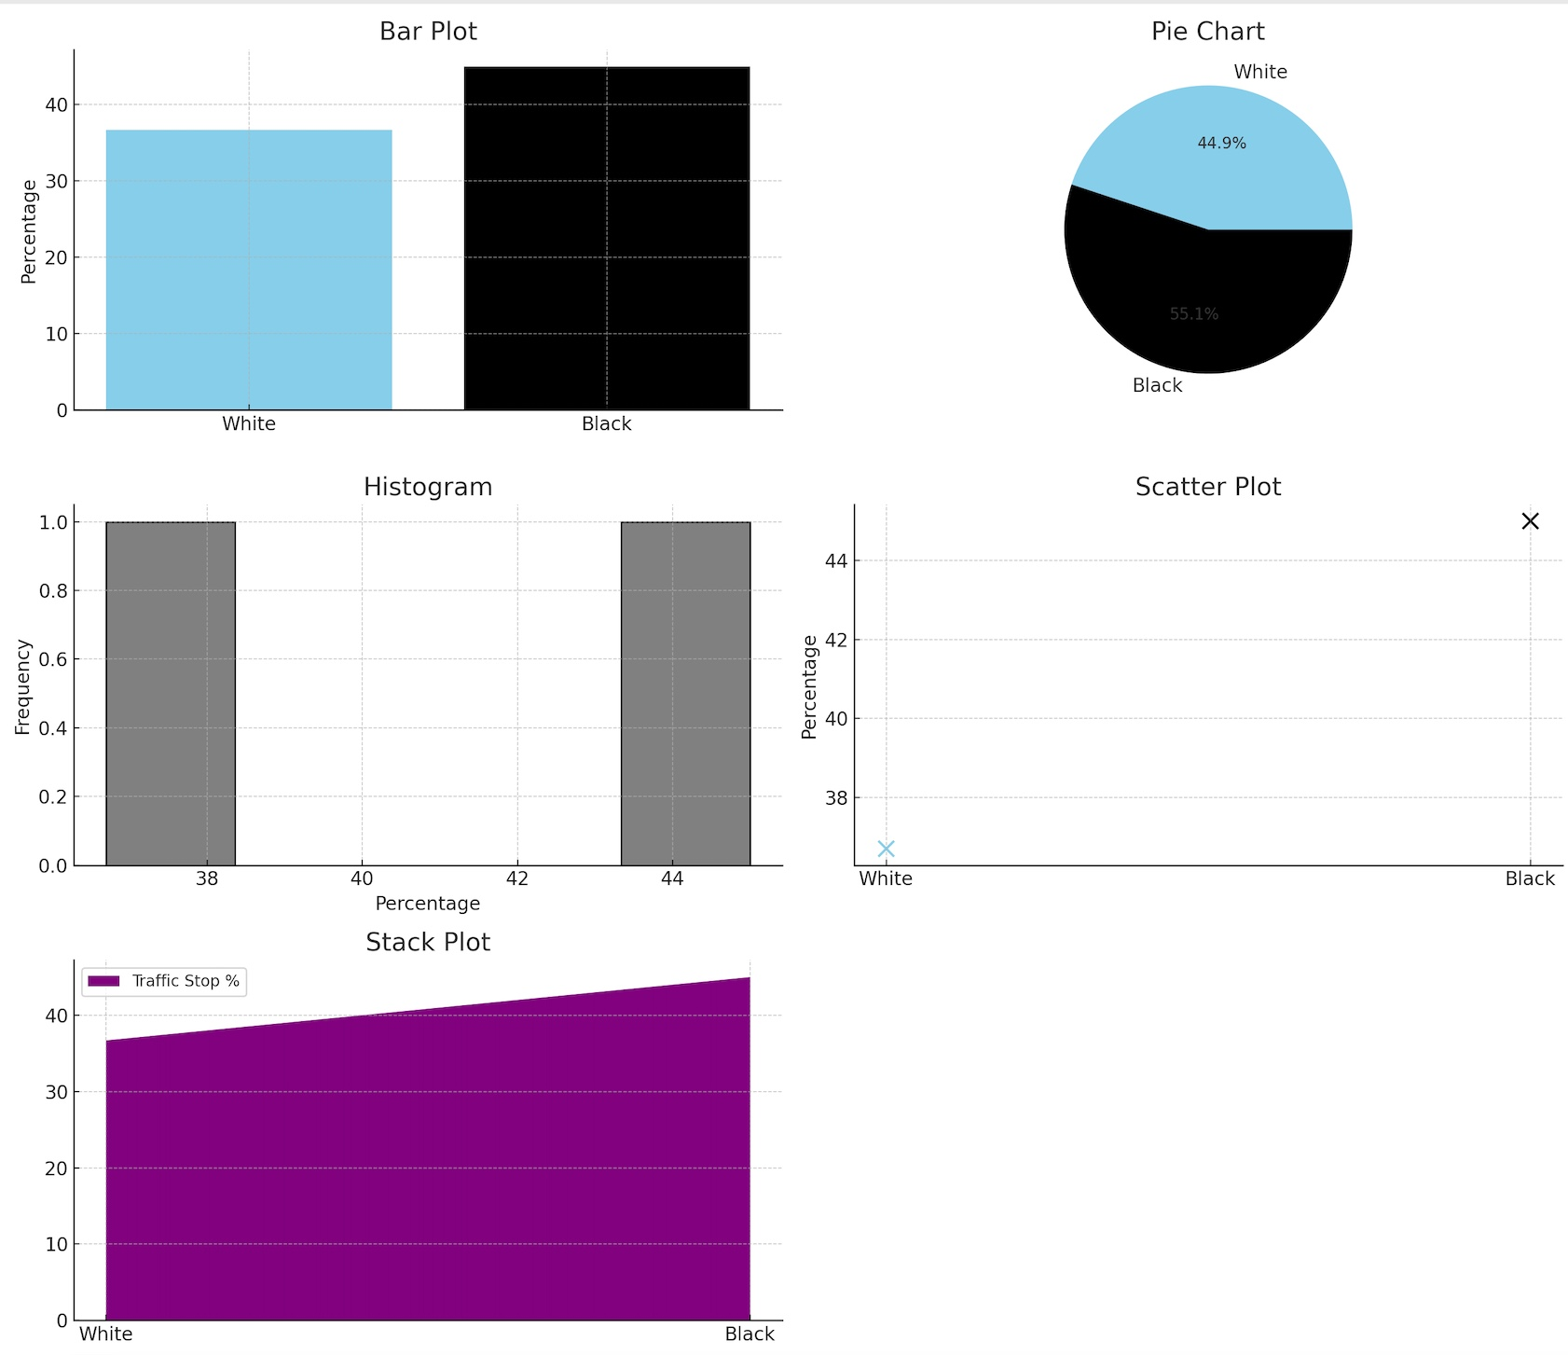
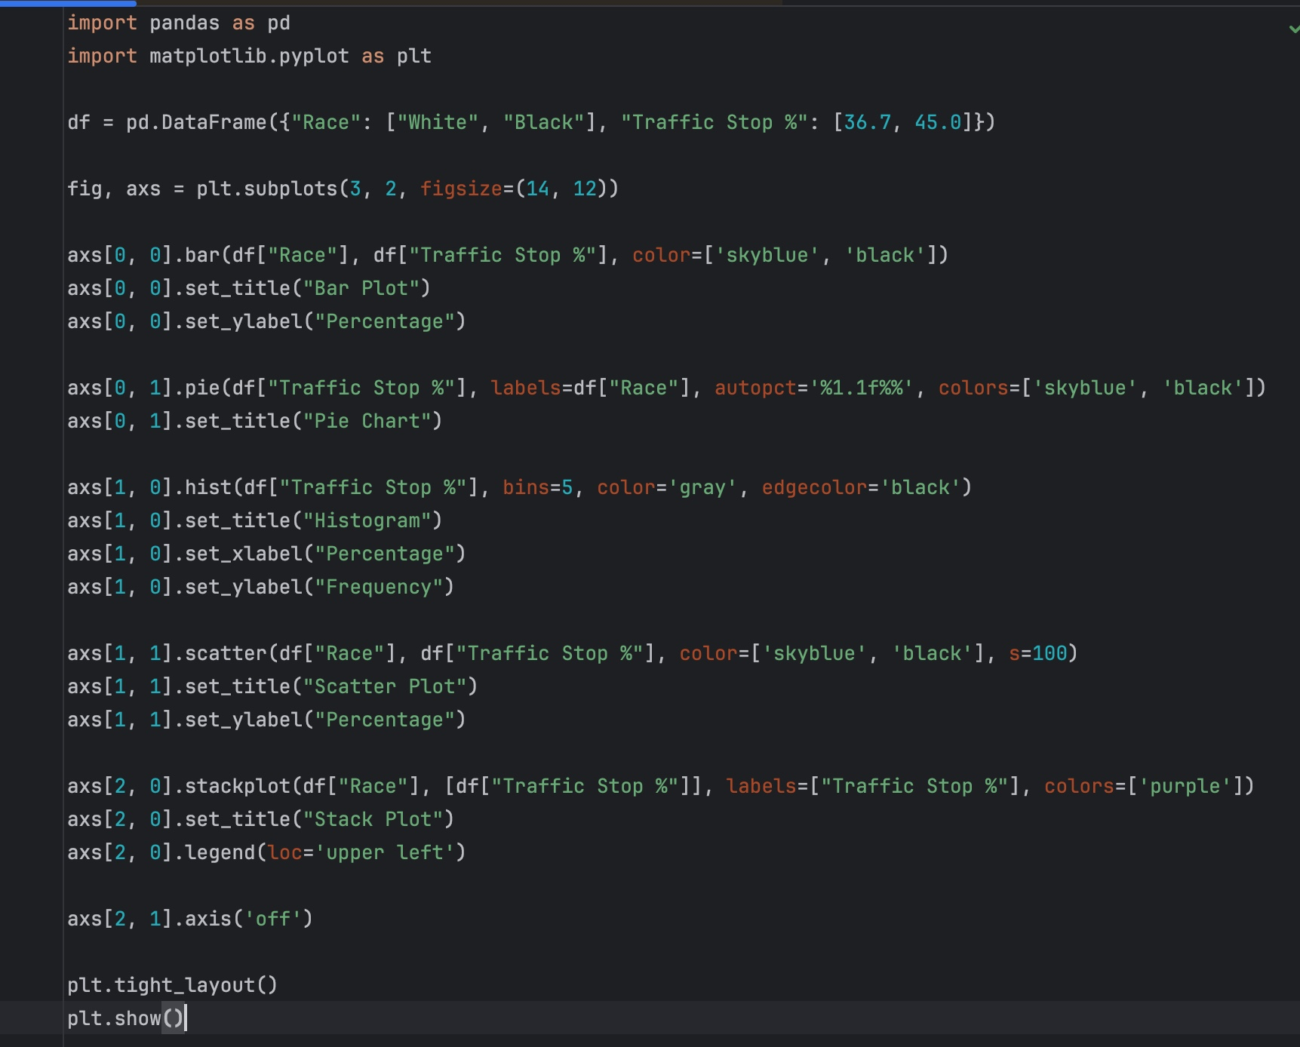

Slide 15
Plot Deliverables (Member 1)

Slide 16
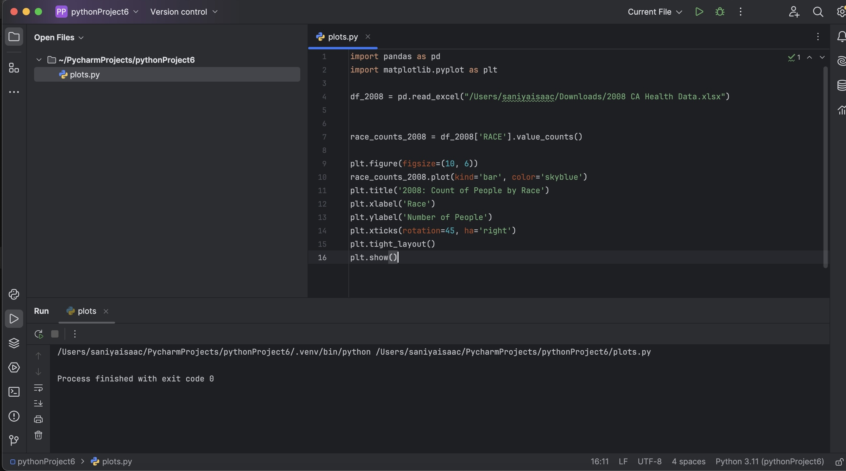
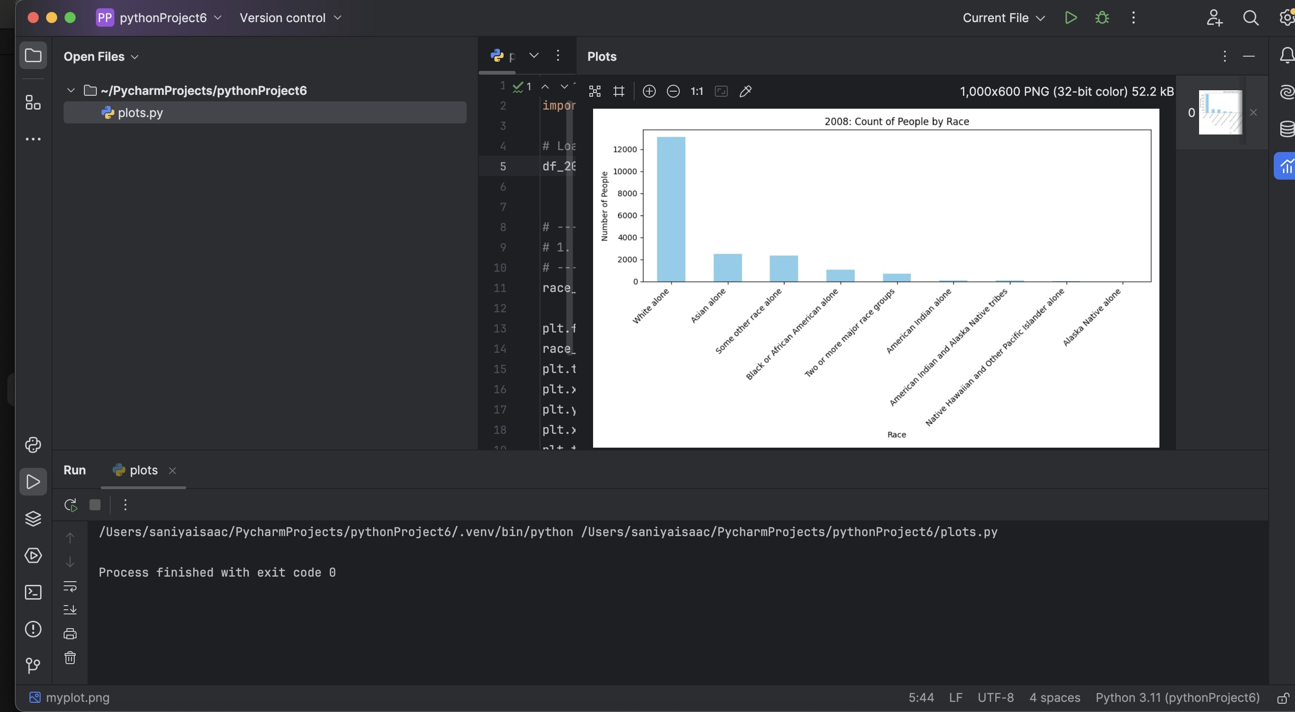

Slide 17
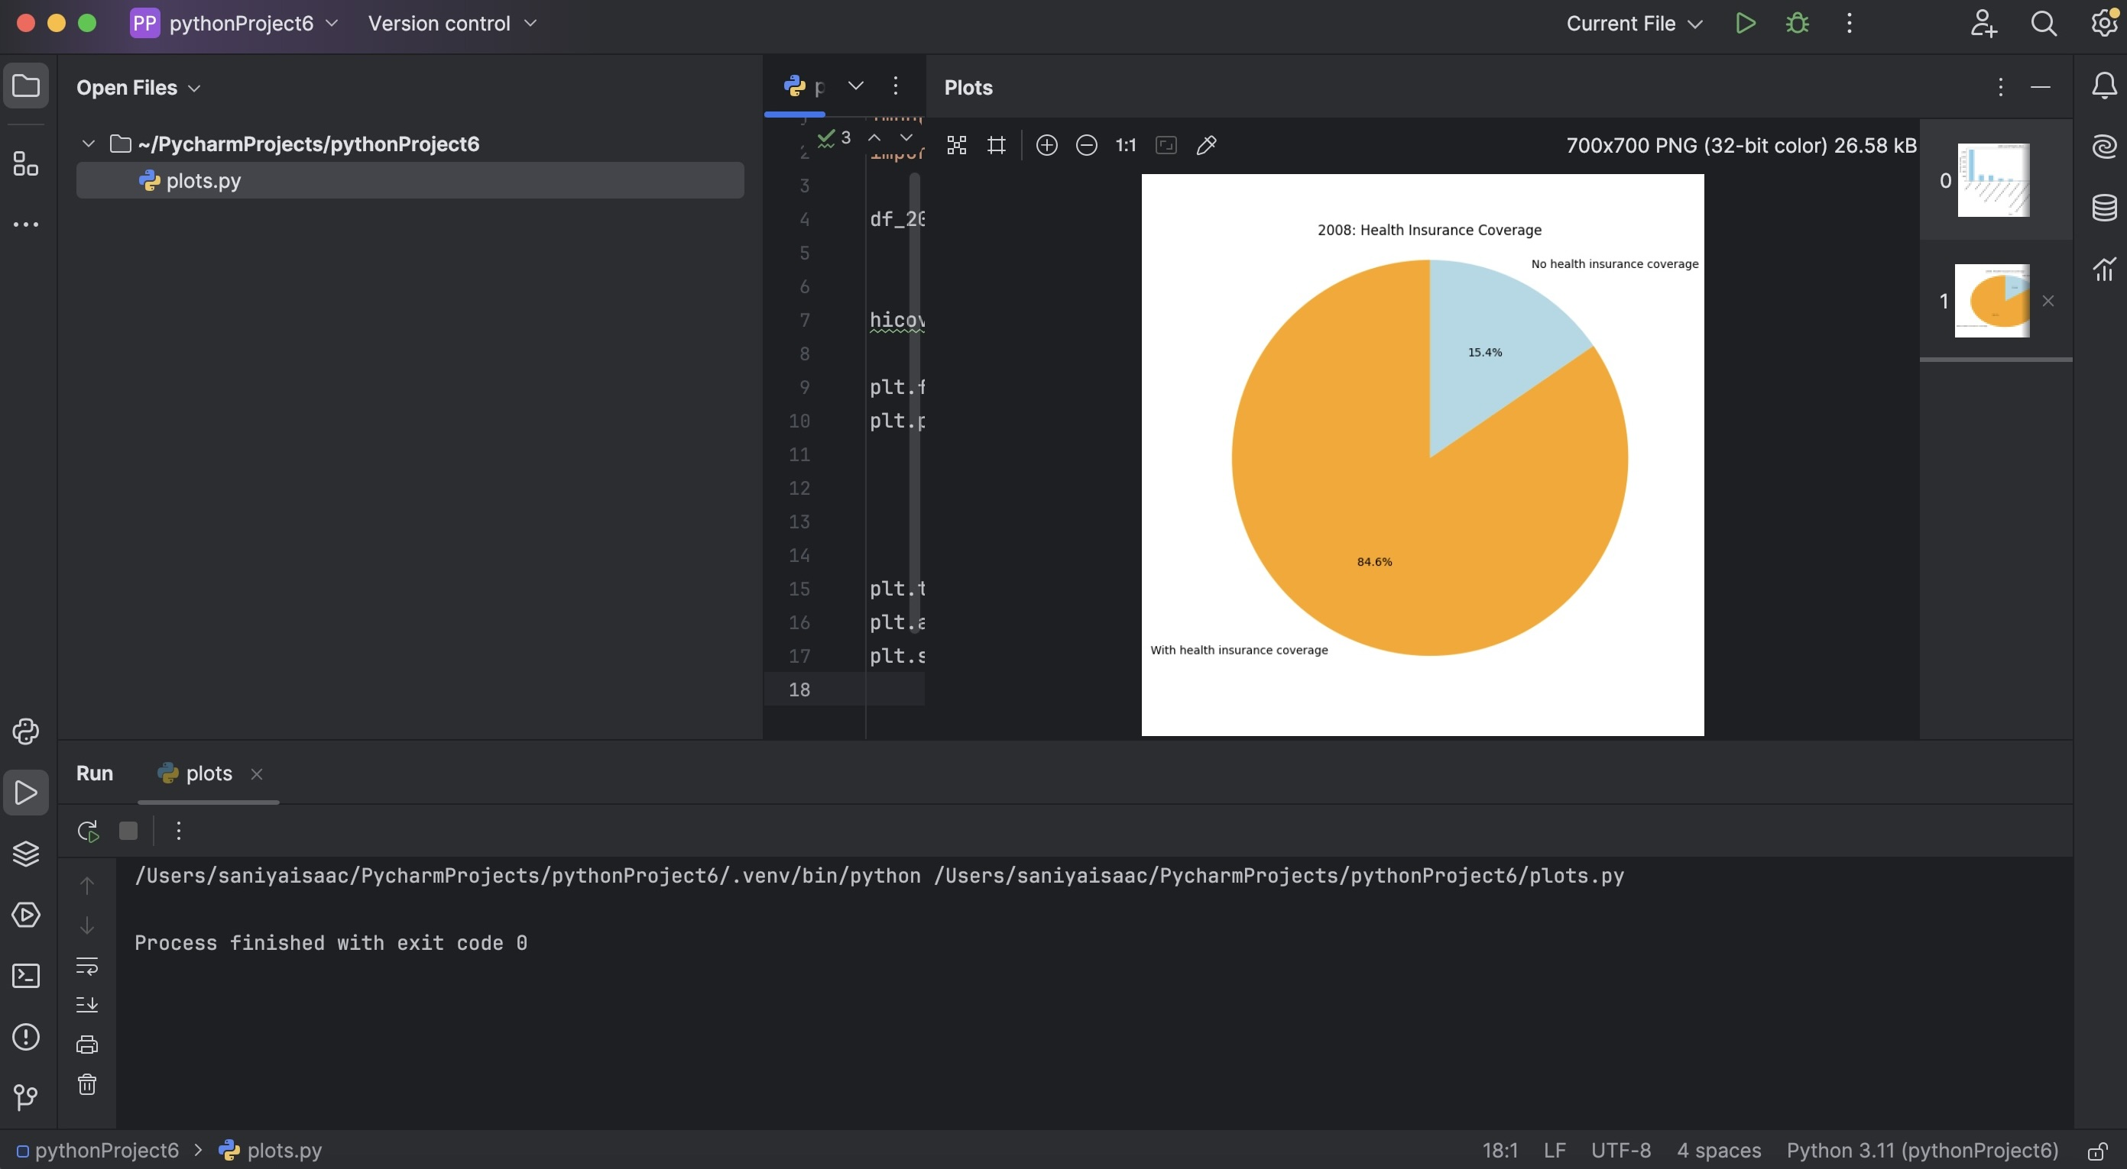
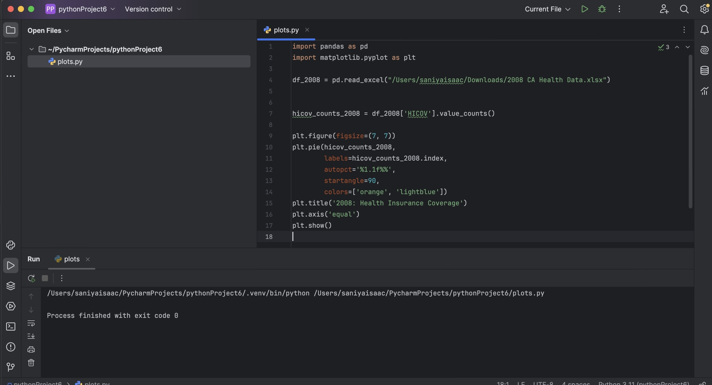

Slide 18
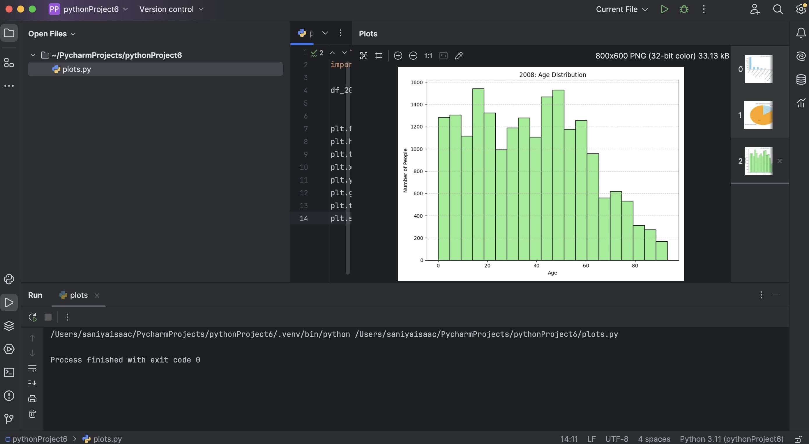
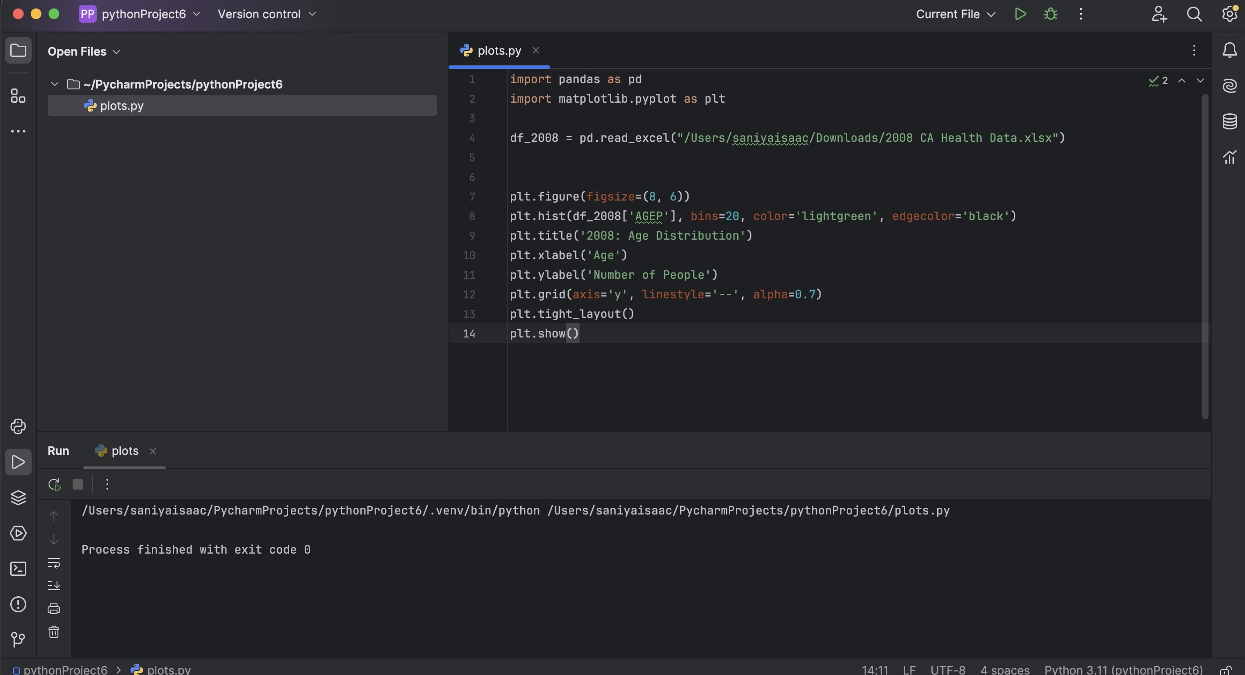

Slide 19
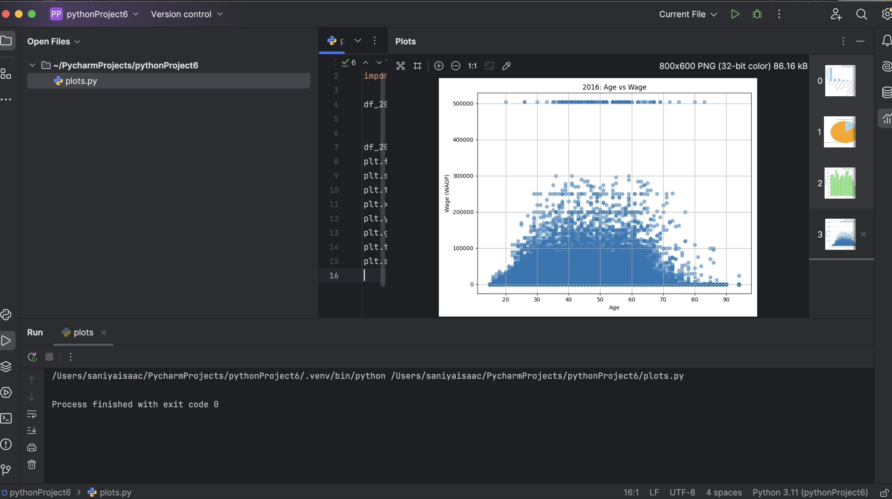
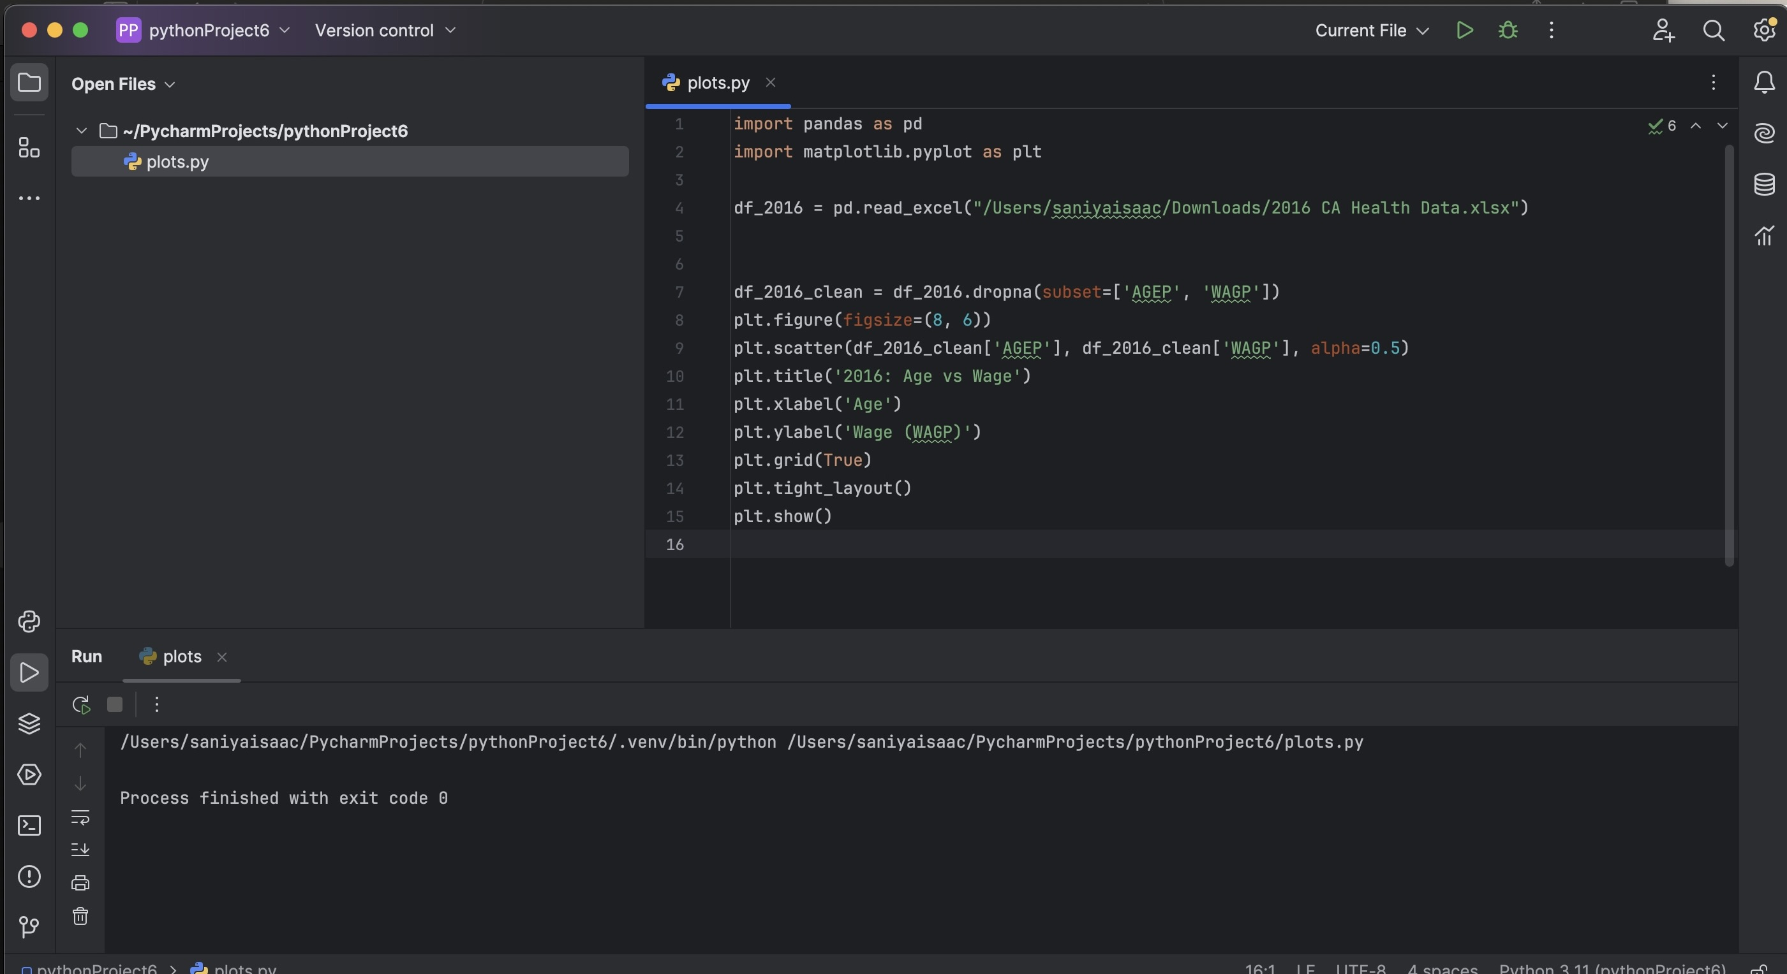

Slide 20
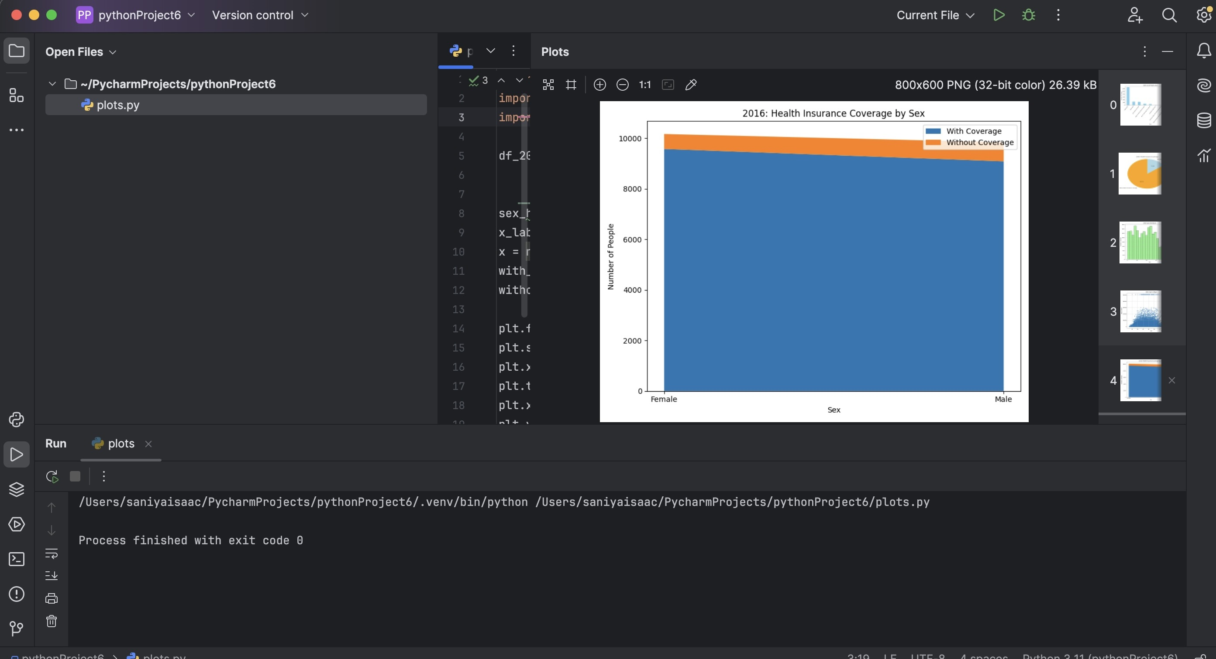
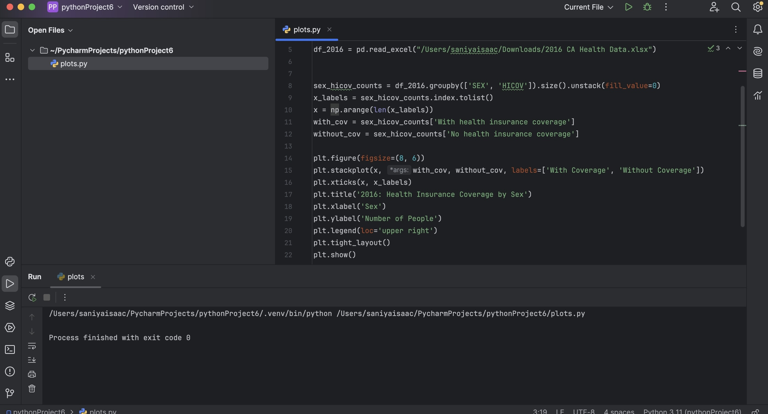

Slide 21
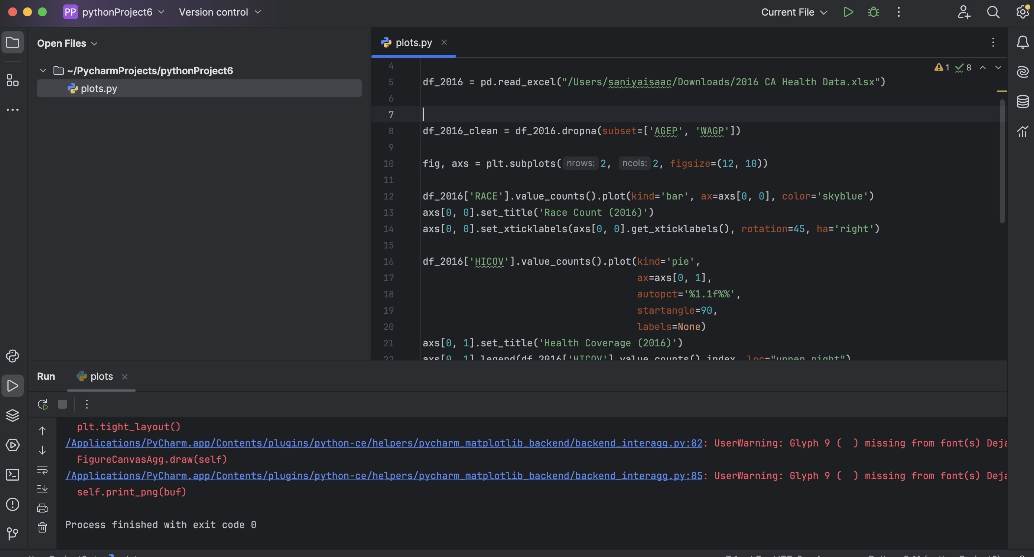
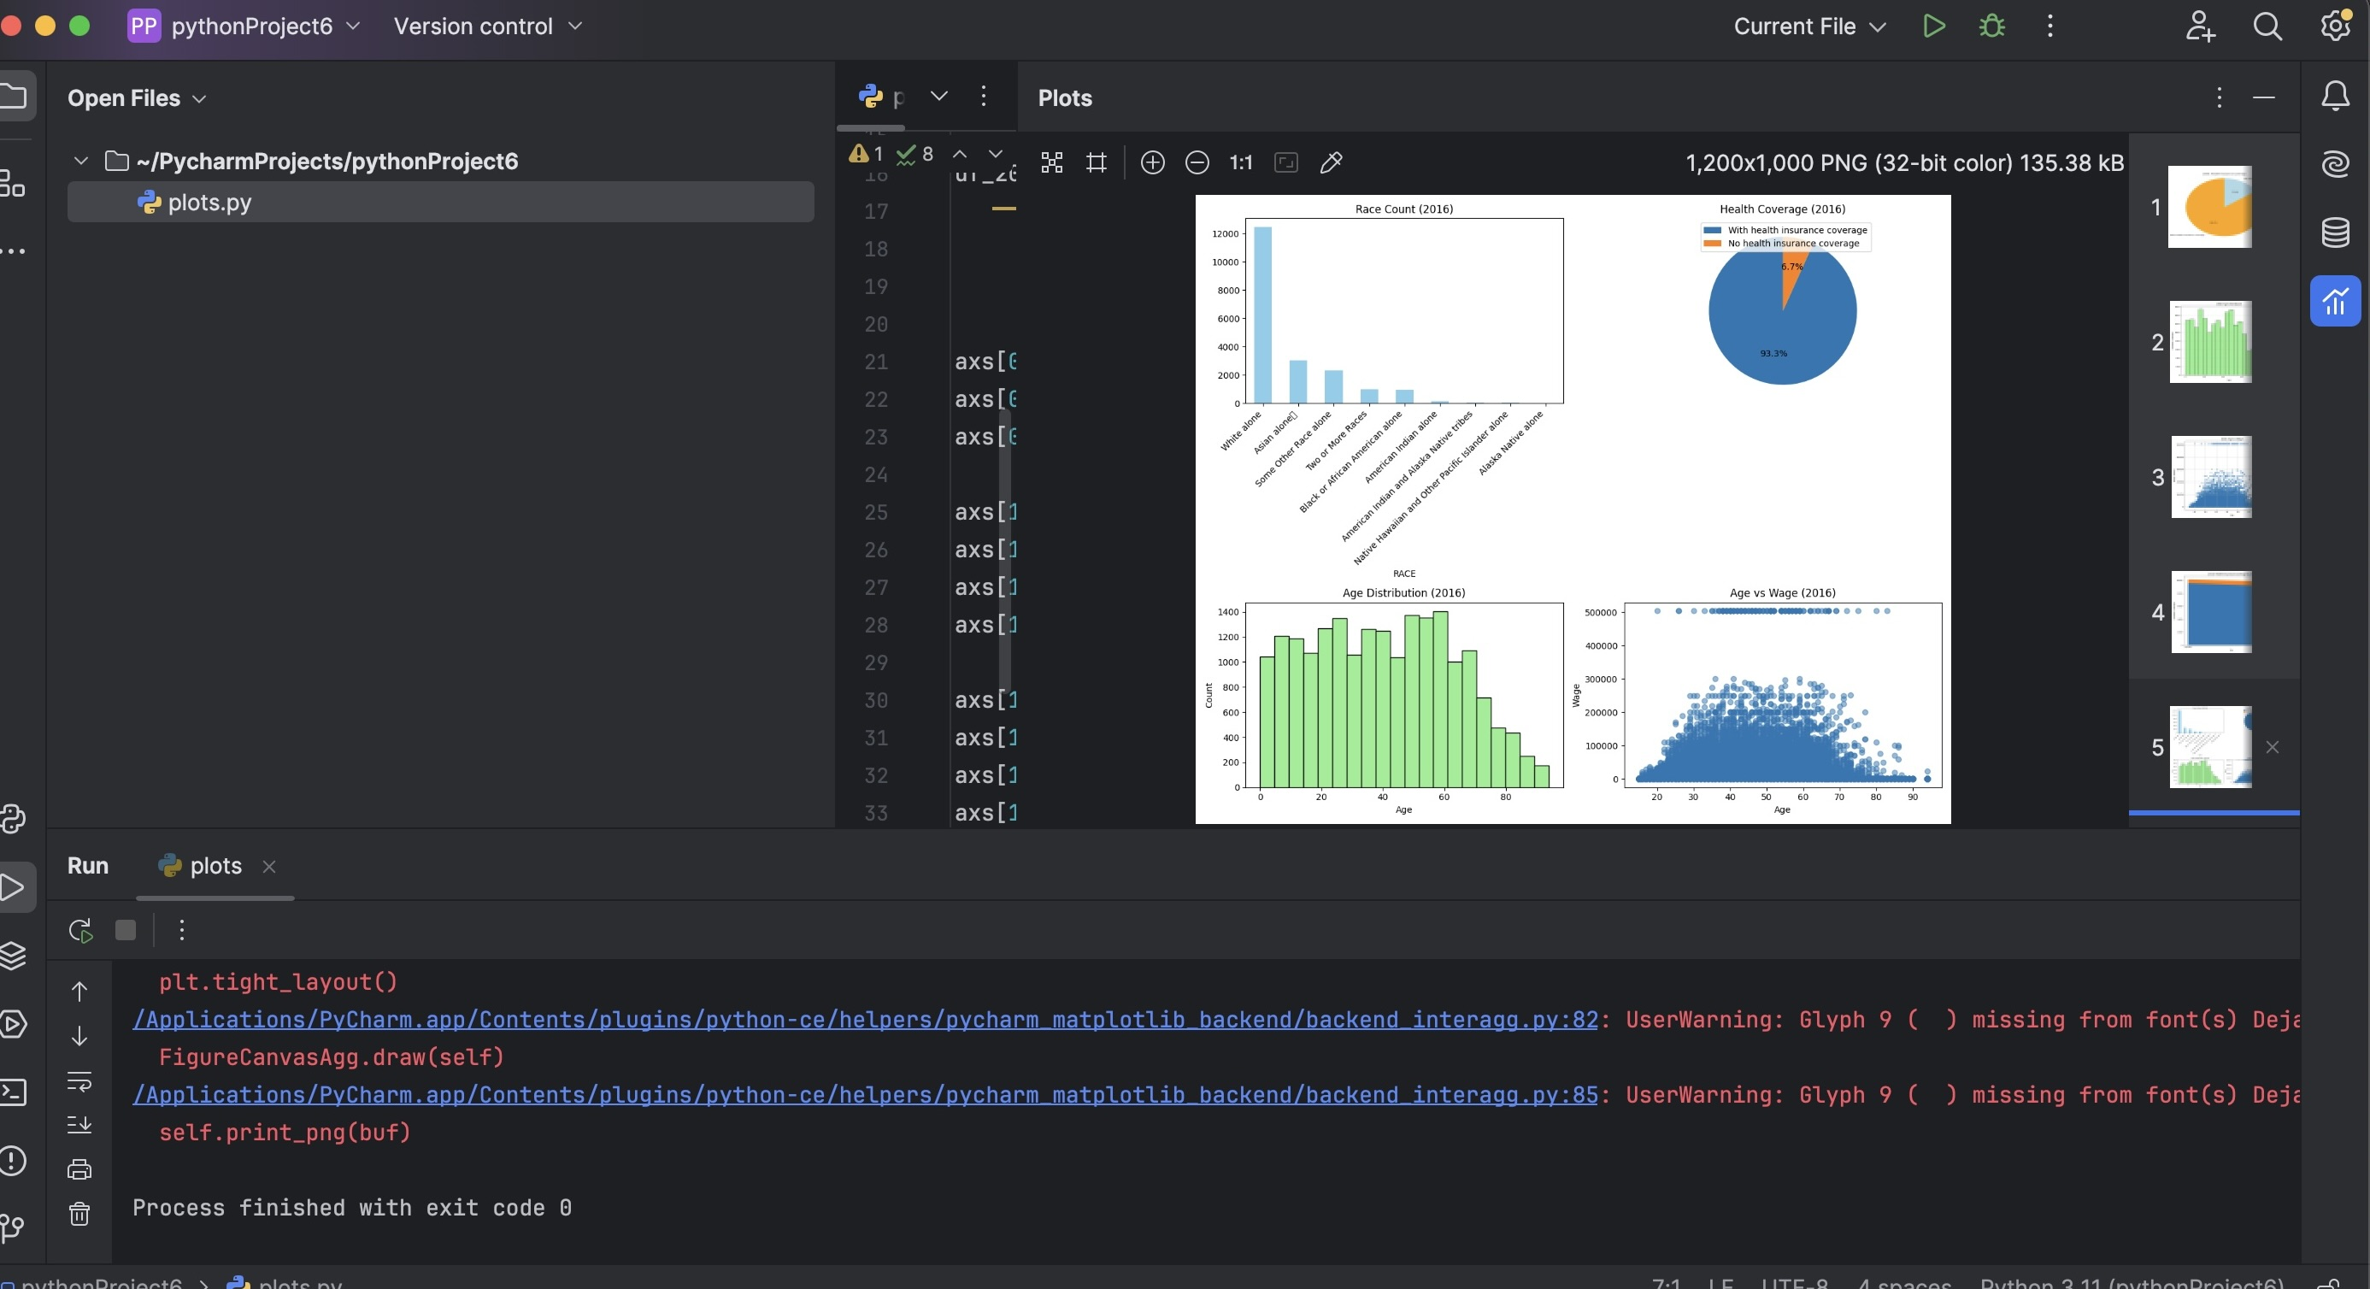
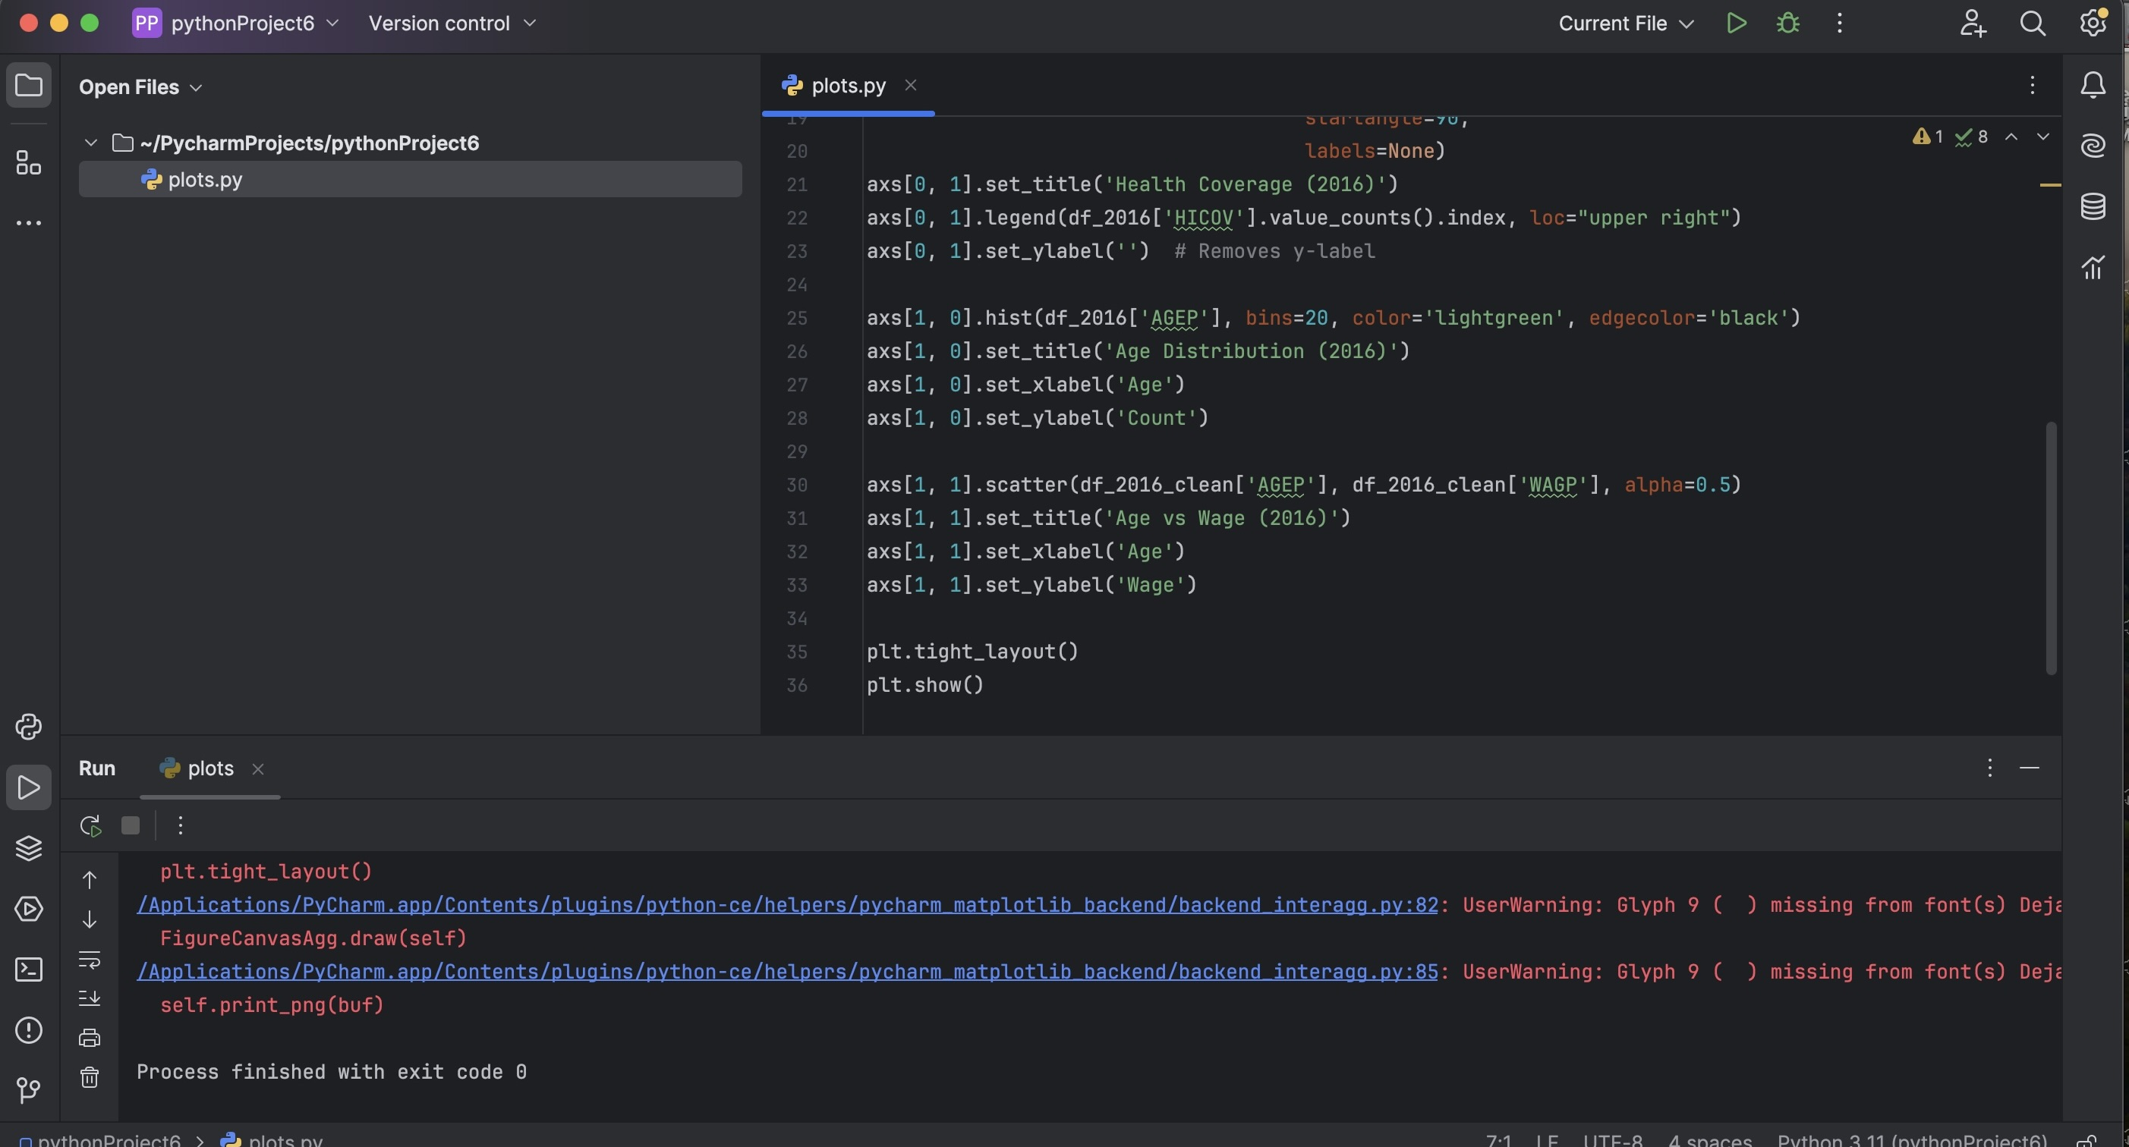
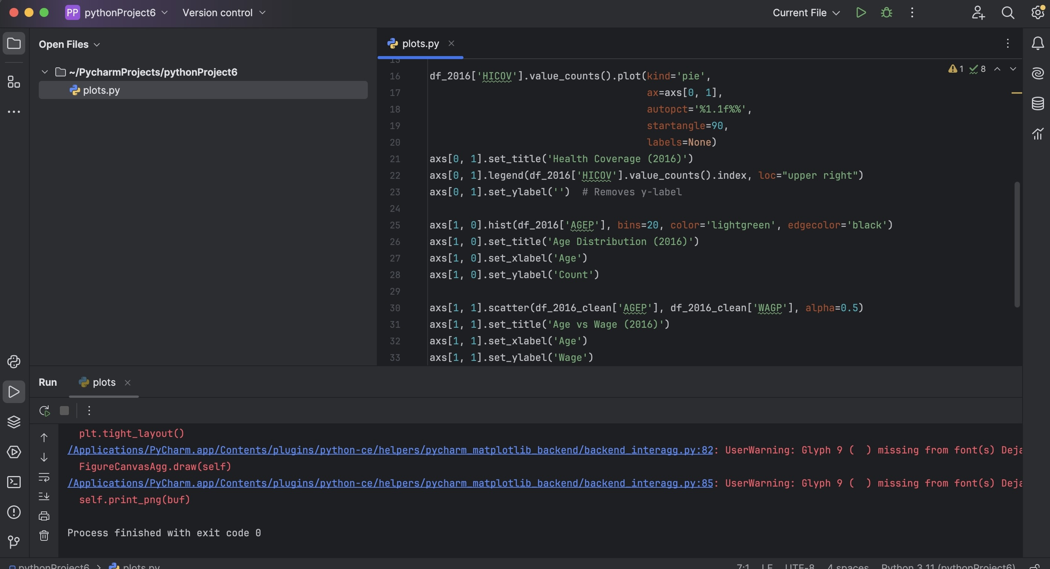

Slide 22
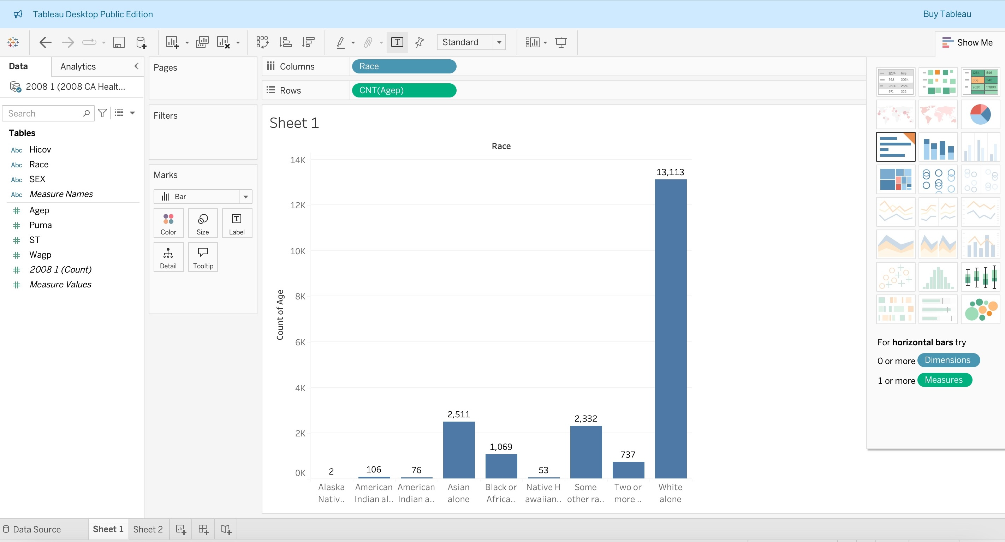
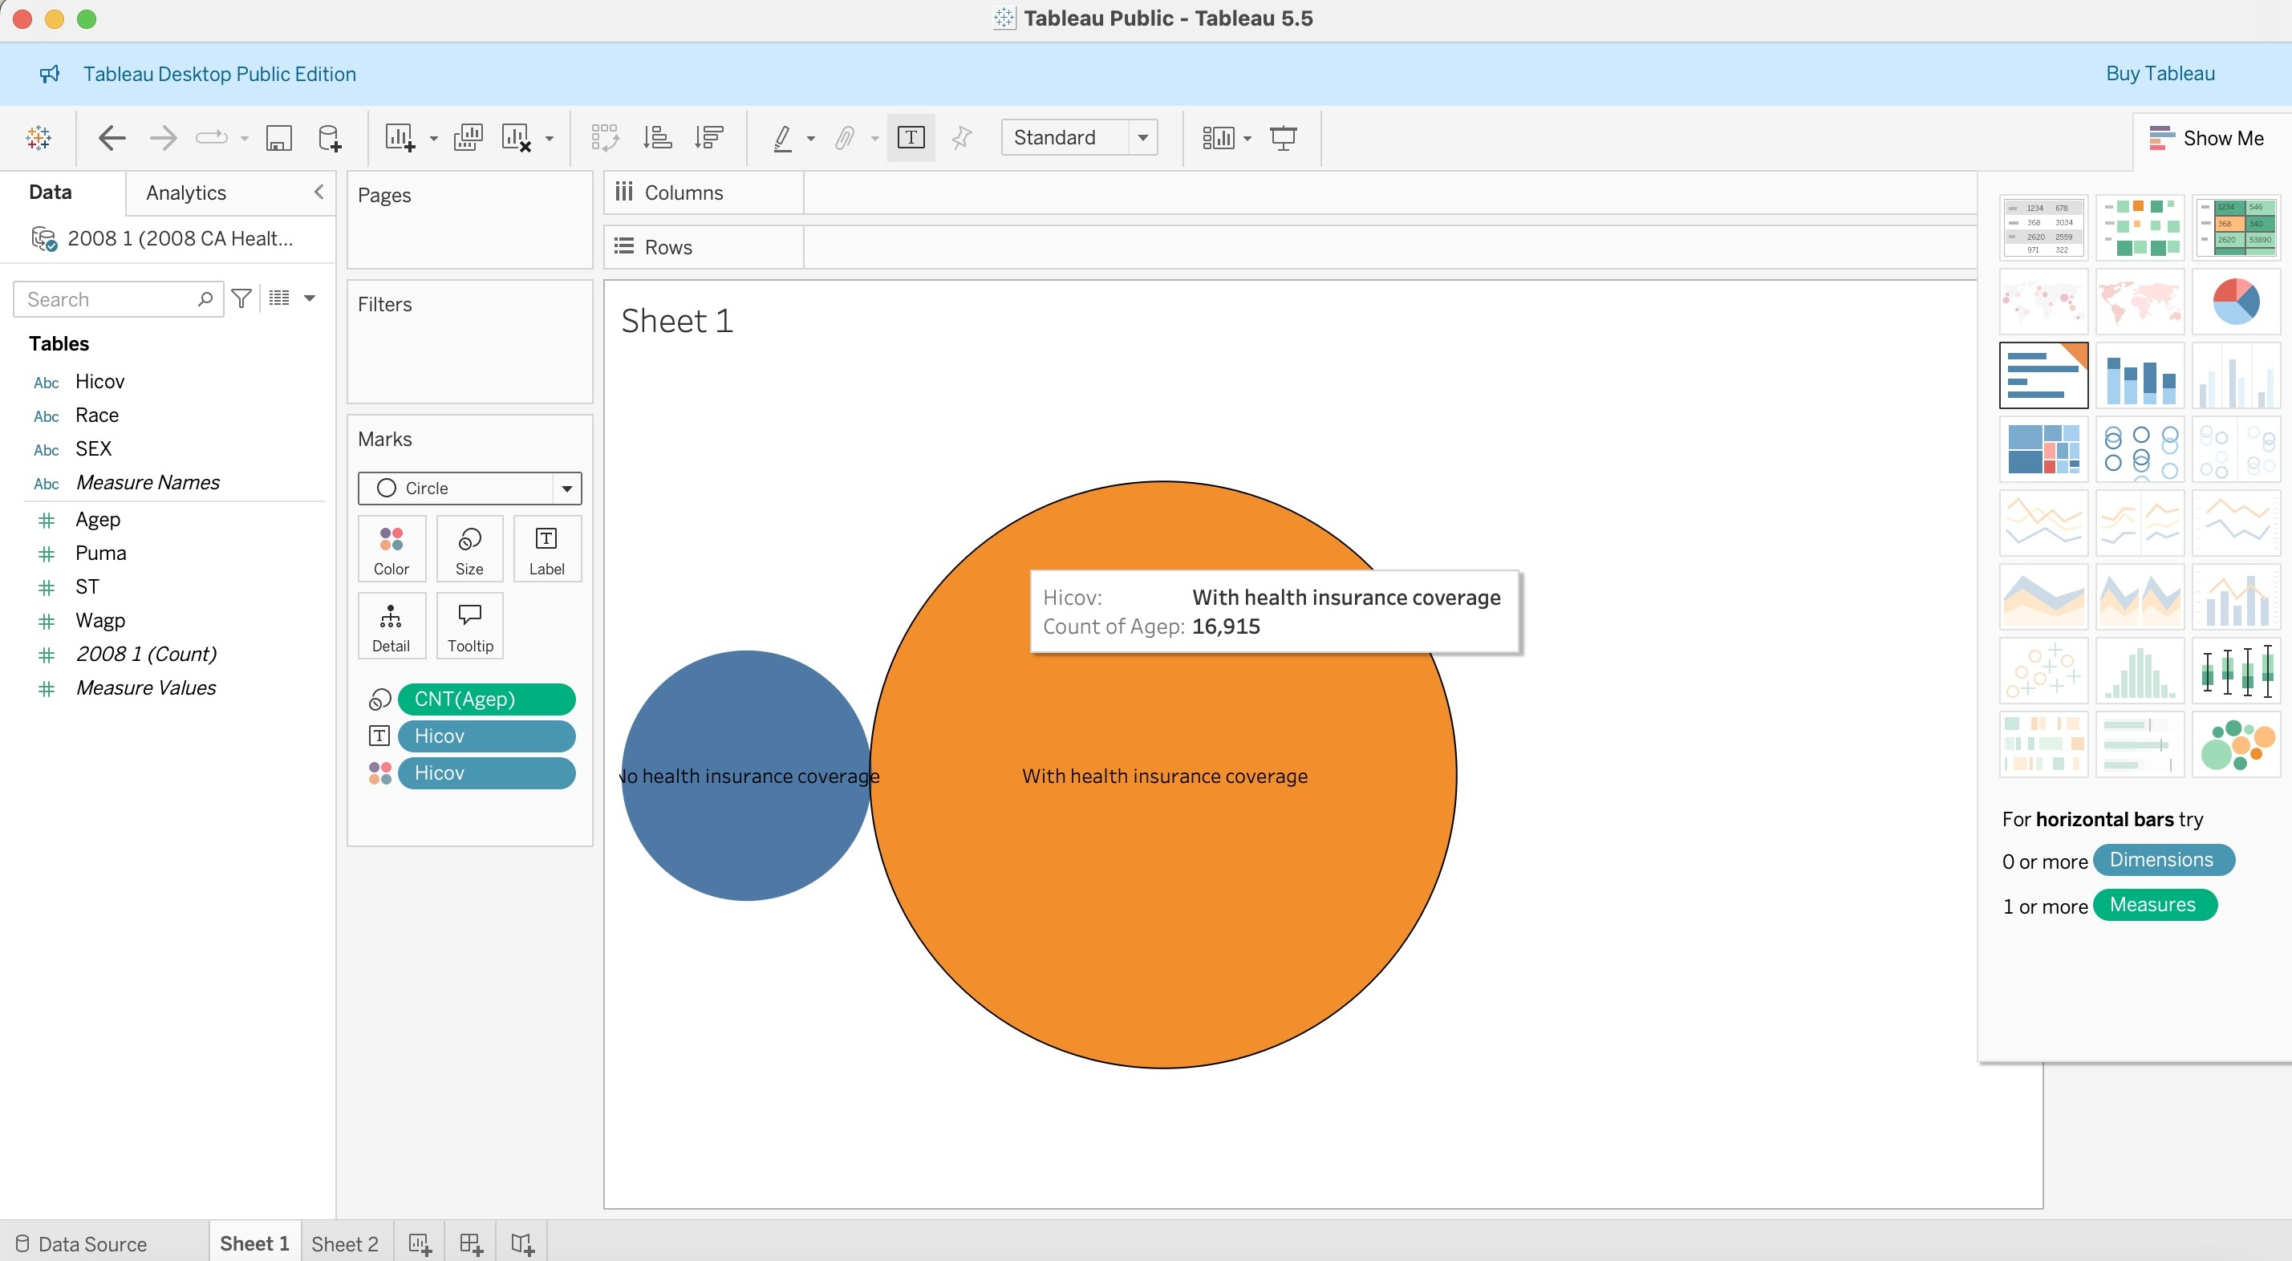

Slide 23


Conclusion
In both CTEC 128 and CTEC 298, we learned how to work with real data to explore important issues. In CTEC 128, one project looked at possible racial bias in traffic stops in Maryland , while the other focused on how the Affordable Care Act improved healthcare access in California. We used raw data, cleaned it, asked questions, and created charts to show our results. In CTEC 298, we expanded on those skills by learning Python, Pandas, Matplotlib, Tableau, and Jupyter Notebook. We completed tutorials and created six different plots based on our CTEC 128 data. These projects helped us see how math, coding, and analysis all work together to better understand real-world problems. In the end, we learned how data can be a powerful tool to uncover truth, support decision-making, and drive positive change in society.

Slide 24
References
U.S. Census Bureau. (2008 & 2016). American Community Survey (ACS) Data. Retrieved from https://www.census.gov/programs-surveys/acs
Healthcare.gov. (n.d.). The Affordable Care Act. Retrieved from https://www.healthcare.gov/where-can-i-read-the-affordable-care-act/
KFF. (2024). Health Policy 101: The Politics of Health Care and the 2024 Election. Retrieved from https://www.kff.org
Maryland Governor’s Office of Crime Prevention, Youth, and Victim Services. Traffic Stop Data Dashboard. https://gocpp.maryland.gov/data-dashboards/traffic-stop-data-dashboard/
Stanford Open Policing Project. Traffic Stop Data. https://openpolicing.stanford.edu/data/
Python.org. (n.d.). Python Documentation. Retrieved from https://docs.python.org
Matplotlib. (n.d.). Matplotlib Documentation. Retrieved from https://matplotlib.org/stable/index.html
Pandas Documentation. (n.d.). Retrieved from https://pandas.pydata.org
Tableau. (n.d.). Official Tableau Help. Retrieved from https://help.tableau.com
GitHub. (n.d.). Project Repositories. Retrieved from https://github.com

